Slide 1
Sales Predictions

Slide 2
Analysis Goal
Helping retailers understand properties of their products to increase sales

Slide 3
Data
Sales data from various grocery stores
Data sample includes small, medium and large grocery stores
Sample size includes 8523 items

Slide 4
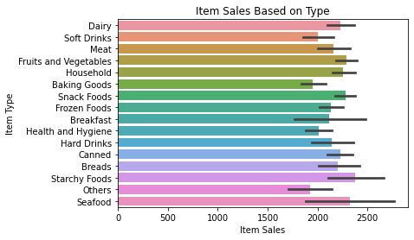
Question 1 : What Items Sell the Most?
Starchy foods and Seafood have the highest sales on average
Seafood Sales vary based on store

Slide 5
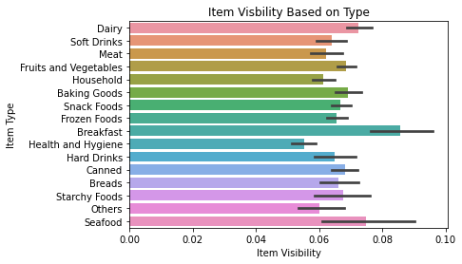
Question 2: Which Items are Displayed?
On average, stores display Breakfast food and Seafood the most
Seafood display varies based on stores

Slide 6
Conclusions
Item visibility has a direct correlation to item sales
Increasing visibility of low selling items will increase sales
Keeping a high stock of Seafood and starchy items will sell

Slide 7
Thank you!
Email: vorhasheel@gmail.com
GitHub: https://github.com/svohra10/sales-predictions
Linkedln:www.linkedin.com/in/sheel-vohra

